Slide 1
Short Course in Linguistics
Intro to Morphology

Slide 2
Topics
Phonetics and Phonology
Morphology
Syntax
Semantics
Identity

Slide 3
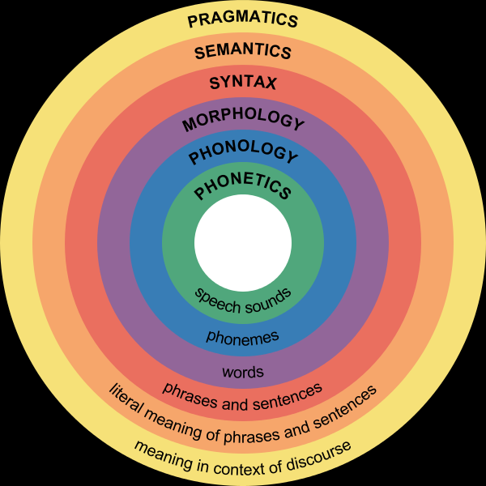
Linguistic hierarchy

Slide 4
Onto today’s topic...

Slide 5
Morphology
Morphology
‘the study of words, how they are formed, and their relationship to other words in the same language. It analyzes the structure of words and parts of words, such as stems, root words, prefixes, and suffixes’

Slide 6
But what is a word?
When we write, we use the spaces between “words” to define them
But when we try to define the concept it becomes a bit more difficult
‘a single distinct meaningful element of speech or writing, used with others (or sometimes alone) to form a sentence and typically shown with a space on either side when written or printed’

Slide 7
But what is a word?
Languages fall on a continuum
At one end we have isolating languages – English is close to this end
Single words, single concepts – cat, dog, kick, run
At the other end, we have agglutinating languages - Georgian
gadmosakontrrevolucieleblebisnairebisatvisaco
Notes:
"(someone not specified) said that it is also for those who are like the ones who need to be to again/back counter-revolutionized"

Slide 8
Morphemes
Words are made of morphemes
These can be defined as the smallest unit that carries meaning
Morphemes come in two types
Free
Bound

Slide 9
Morpheme types
As the name suggests, these morphemes can stand by themselves
Cat
Dog
Monkey
Green
Bound morphemes need to be attached to something
un-
able-

Slide 10
But it’s not as simple as that...
There are a range of different ways morphemes can be combined
Compound words
Derivation
Inflection

Slide 11
Compound words
In English, some of these are easy
fire + man = fireman
blue + berry = blueberry
raspberry?
In Thuntai
them + them + ngan (nose + nose + person) = s.o. who is jealous
yanche + per (meat + tree) = cassowary

Slide 12
Compound words
Many compound words need to be treated as individual lexical entries
Meanings not generally obtained directly through additive process

Slide 13
Derivation and Inflection
Both derivation and inflection involve the addition of bound morphemes to free morphemes
Derivation is the process of creating a new word from another
Inflection is the process of adding ‘nuance’ to a word

Slide 14
Derivation
Vandal + ise = vandalise (one who behaves like a vandal)
Help + ful = one who is full of help
Close + ly = in a close manner
What about idol + ise? Is it one who behaves like an idol?

Slide 15
Derivation
Derivation generally changes the type of word
Vandal (a noun) + ise = vandalise (a verb)
Help (a verb) + ful = helpful (an adjective)
We can see the change in category (this doesn’t always happen but its a very good sign)
They are semi-regular, as the idolise example shows, but it is easier to generalise the formation of derived words than compound words

Slide 16
Derivation
Leads us to think that we can treat morphology as additive
If we take one morpheme and add successive morphemes to it we can build meaning up in a regular way
Linguists call this item and arrangement morphology
In all but a handful of cases, this approach is largely unsupported

Slide 17
Inflection
Inflection adds nuance to a word
This isn’t a particularly useful description
How about inflection adds grammatical information?
This probably doesn’t help without some examples

Slide 18
Inflection
In English –
love + s = loves
dog + s = dogs
Both examples use an ‘s’ to add grammatical meaning, but it isn’t the same meaning
We need to unpack this a little further

Slide 19
Inflection
Firstly we need to take a look at the types of words we’re dealing with
Verbs – love, hit, kick, stand, sit
Nouns – dog, cat, cow, laptop
Now we need to put them in a sentence or two...
I hit him.
He hits me. -> we needed the ‘s’ here because the subject of the sentence was third person

Slide 20
Inflection
But what about with nouns?
He looked at the dog.
He looked at the dogs. -> the ‘s’ here is indicating that there is more than one dog.
So its actually two different inflectional suffixes

Slide 21
Inflection
With this information, we can generalize the two cases
Verb + ‘s’ = 3rd person singular actor + verb
Noun + ‘s’ = plural noun
There are a long list of inflection elements in English, whose application is very simple –
-ing, -ed, -s .........

Slide 22
Inflection
But English does have some hangovers from earlier times
Child -> children, ox -> oxen
These are plural forms formed by adding ‘-en’ to a weak verb
Tooth -> teeth, mouse -> mice
Vowel alternations are another hangover from earlier stages of the language
Also occur in verbs – see -> saw, sang -> sung

Slide 23
Inflection
But English doesn’t show us why item and arrangement doesn’t work
Let’s consider a Thuntai verb...
Consider this picture

Slide 24

Inflection
Can you describe the way the light is shining through the small spaces in between the leaves in one word?
The villagers in Wando can....
nganamaterei
Which translates roughly as ‘the light shone through the leaves reflecting off them on the way through’

Slide 25
Inflection
Let’s unpack it a bit...
Nga – n – amat – er – ei
It’s actually five morphemes
Nga – reflexive
Mat – to shine through
Rei – continuous motion
Na – hither

Slide 26
Inflection
And this is by no means the most complex example of a verb in this language
nga-n-ambri-ngg-oi-yek
‘ We returned.’ but it incorporates elements of the direction we were travelling, the fact that the journey was discontinuous and the fact that it happened a long time ago
And the morphemes themselves are discontinuous...

Slide 27
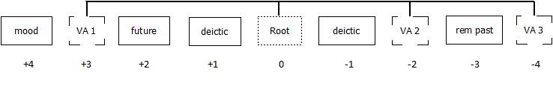
Verb Template

Slide 28
Inflection
These types of examples are trickier
Maybe there are better ways to think of them than as additive pieces
We need to start thinking about them in terms of paradigms to reduce the complexity

Slide 29
Paradigms
Paradigms are effectively tables of related forms
They provide us with an easy way to look up the inflection of a set of terms

Slide 30
Inflection
Paradigms are good for languages that have tricky morphology, like Arabic
darasa he studied, madrasa school
kataba he wrote, maktab office
ṭabaxa he cooked, maṭbax ?
{past} = a / C_C_C
{place where} = ma… a / _CC_C

Slide 31
Inflection in Turkish
Verb Characteristics
with predicative endings | progressive |  | -mekte
 | necessitative |  | -meli
 | aorist (habitual)^{[5]} | positive | -(i/e)r
 |  | negative | -mez
 |  | impotential | -(y)emez
 | future |  | -(y)ecek
 | inferential perfective |  | -miş
 | imperfective ^{[6]} |  | -iyor
with verbal endings | perfective^{[7]} |  | -di
 | conditional |  | -se

Slide 32
Or there’s that Australian language...
Murinh – patha
Spoken in the Daly River area near Wadeye
There are 35 different verb classes, with 35 distinct sets of inflectional suffixes and infixes
And the division of verbs into them makes no sense, even to the speakers, they just learn them....

Slide 33
Other word formation processes
Reduplication
Ilocano: pingan dish ~ pingpingan dishes
Chinese: hong red ~ honghong very red
zou walk ~ zouzou walk a bit
Back – formation
cherry cerise
pea pease

Slide 34
Eponyms
Using people or product names to describe things:
Hoover
Kleenex
Jumbo
Sandwich

Slide 35
Why do we care?
We need to know about morphology for a range of NLP applications
Machine Translation
Named Entity Recognition
Sentiment analysis
Semantic understanding
POS tagging

Slide 36
But morphology seems really hard...
Morphology is really hard
There are far more theories about morphology than there are actual theoretical morphologists
We need to be able to unpack the morphology of a language to be able to efficiently process it

Slide 37
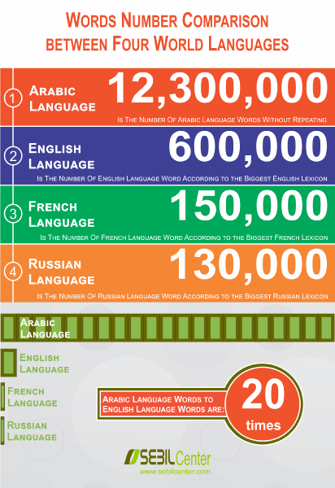
Lexicons
Lists of words
We’d probably like to not search through an entire list of words for a language every time we hit a word
And we’d probably like to be able to generalise so that we don’t need every word stored in the lexicon
So we need to create some rules to be used with the lexicon

Slide 38
FSA’s and FST’s
So we can deal with a lot of these rules by writing Finite State Automata and Finite State Transducers
FSA’s are used in tools like spell checkers, they determine whether or not a string is a real string
FST’s allow you to provide input and return an output
So,
CAT + Noun + PL => CATS

Slide 39
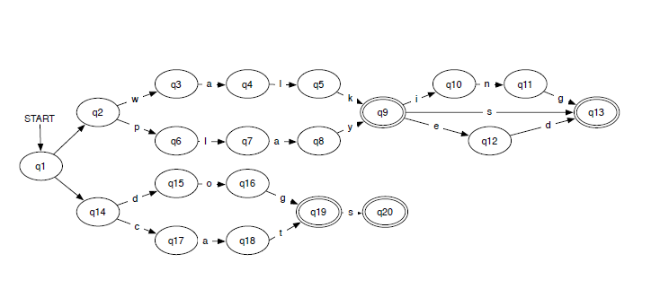
FST Example

Slide 40
Next time...
Morpho-syntax
Syntax
A brief look at some more exciting NLP applications...

Slide 41
Questions?
I understand that was pretty long but I would really like some questions and or feedback so that I know that I haven’t put you all to sleep!!

